Slide 1

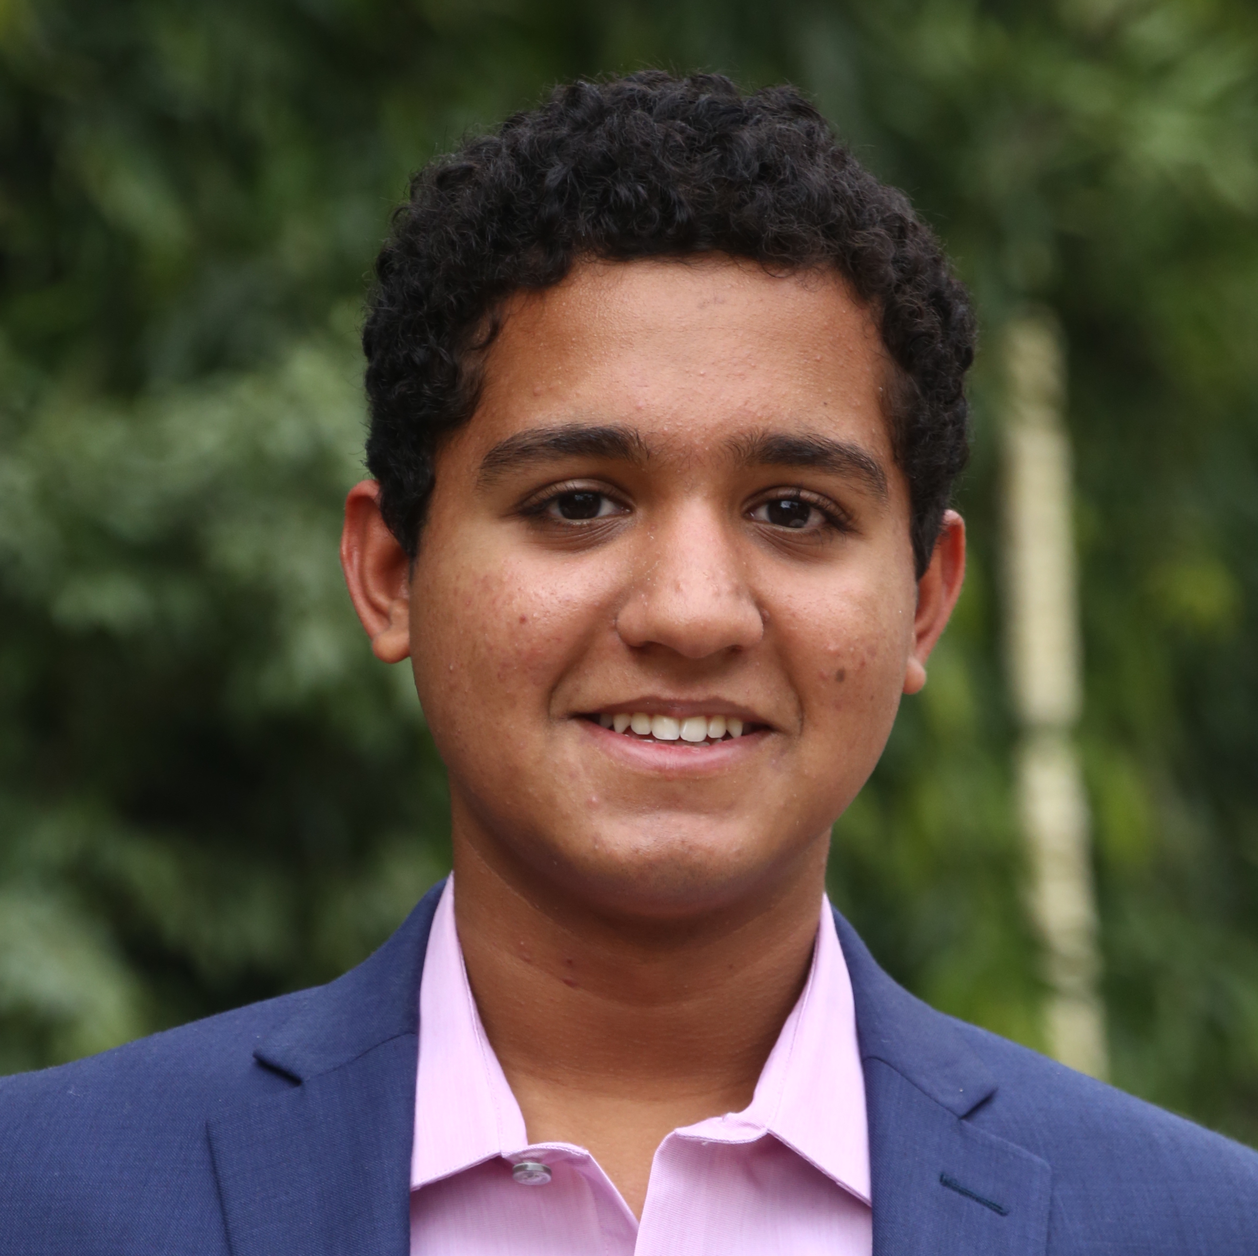
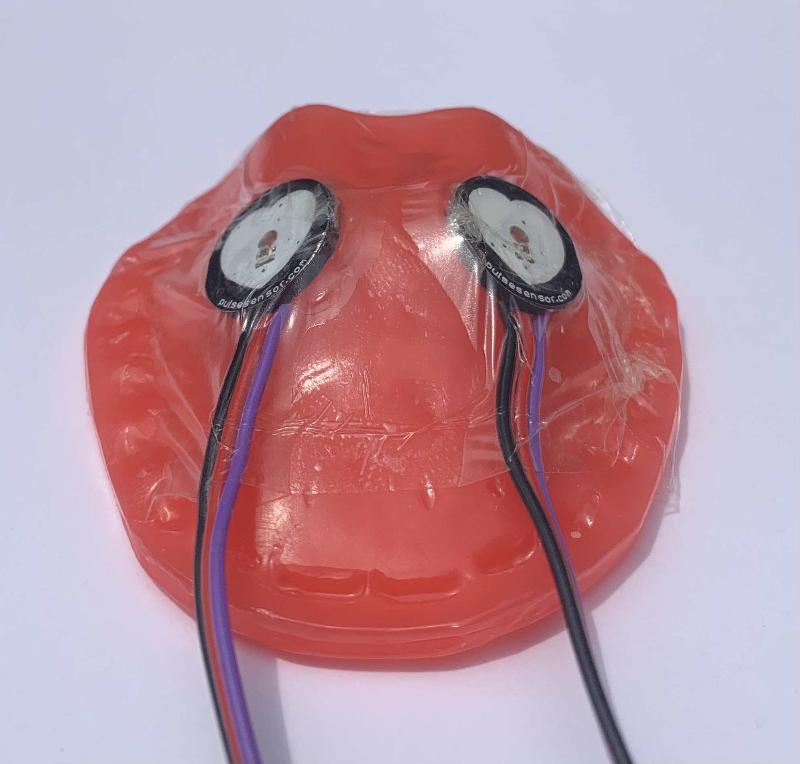
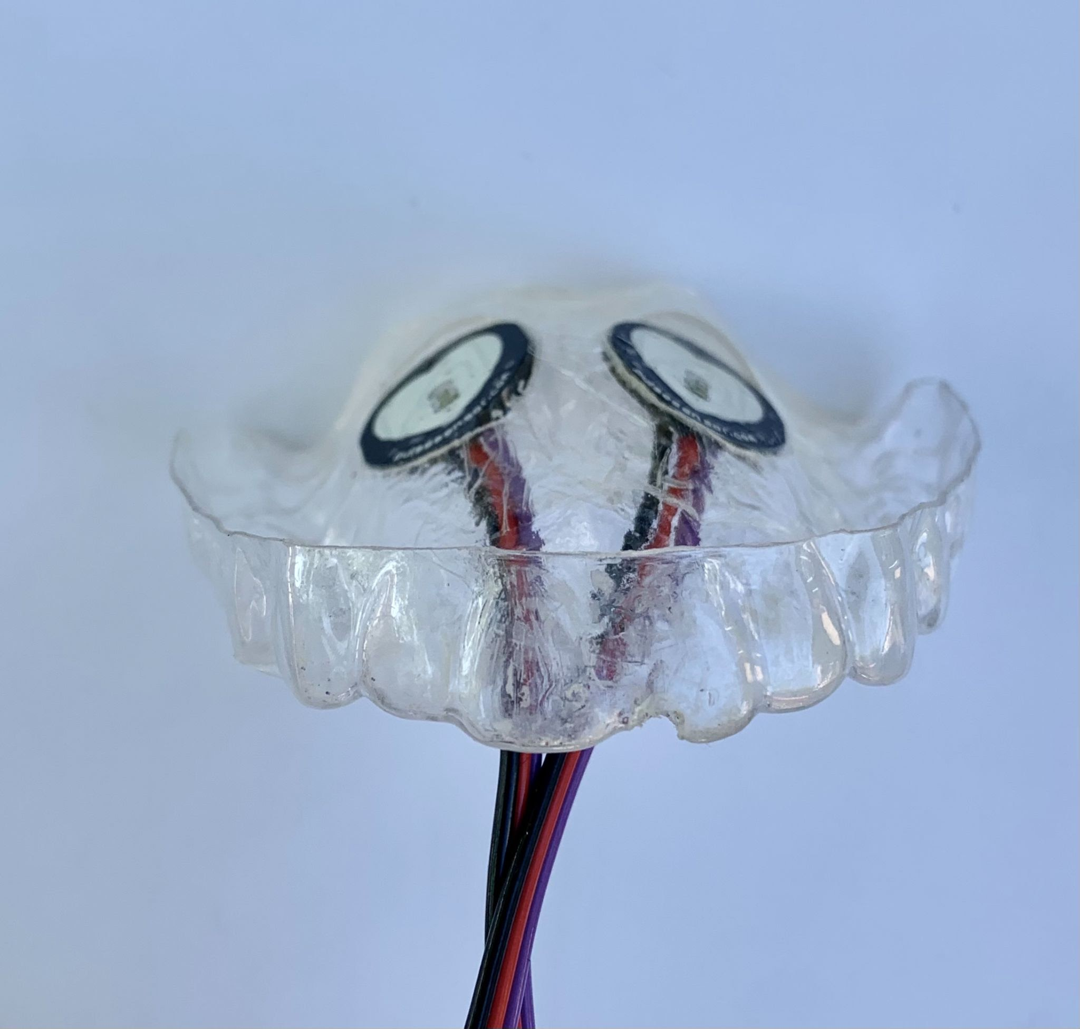
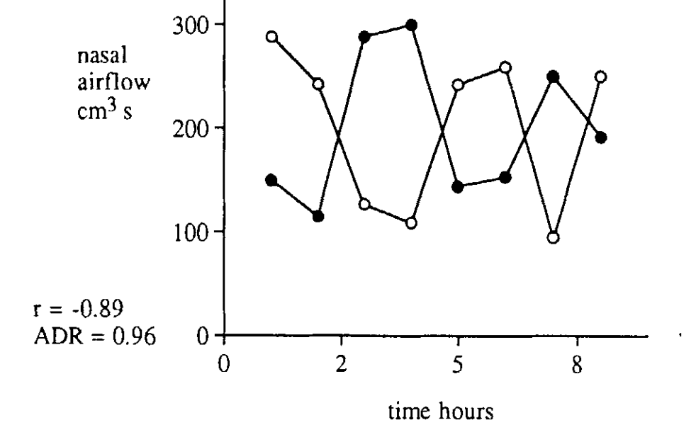
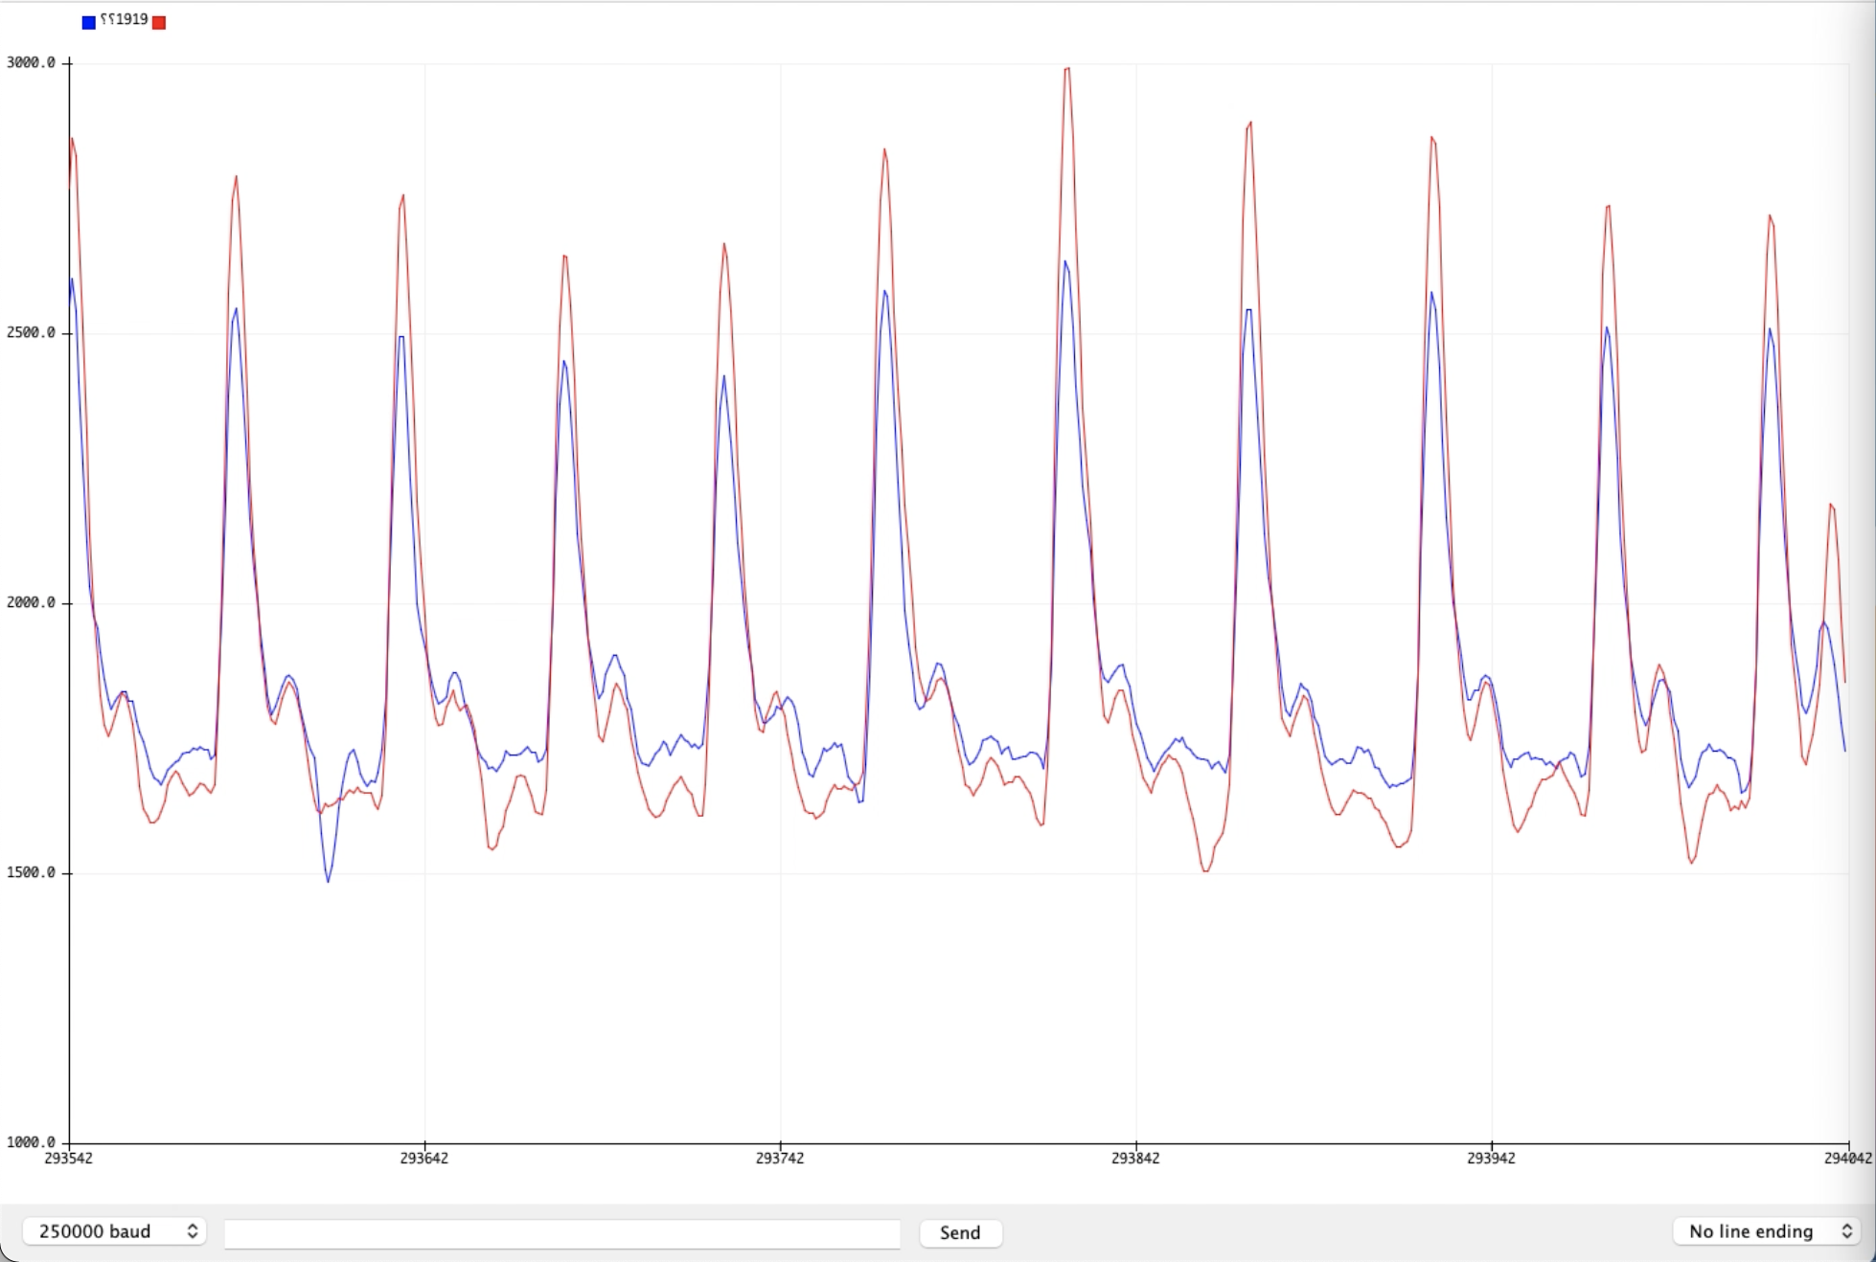
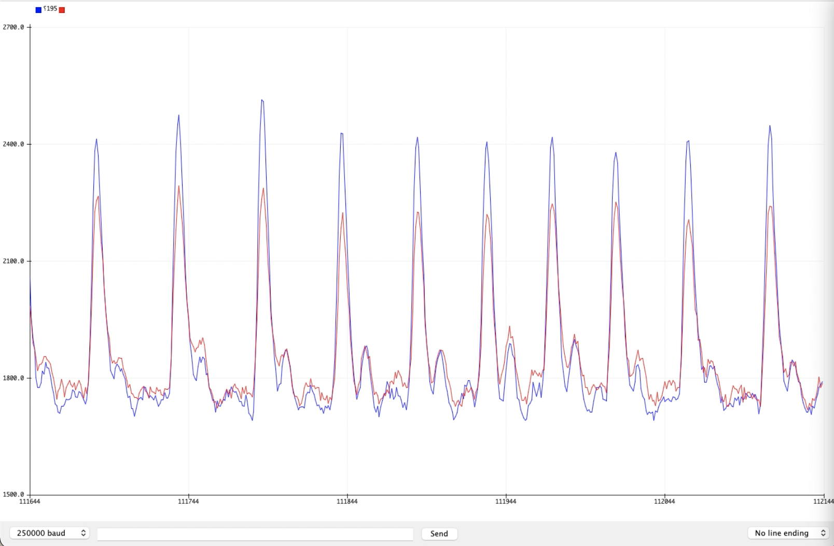
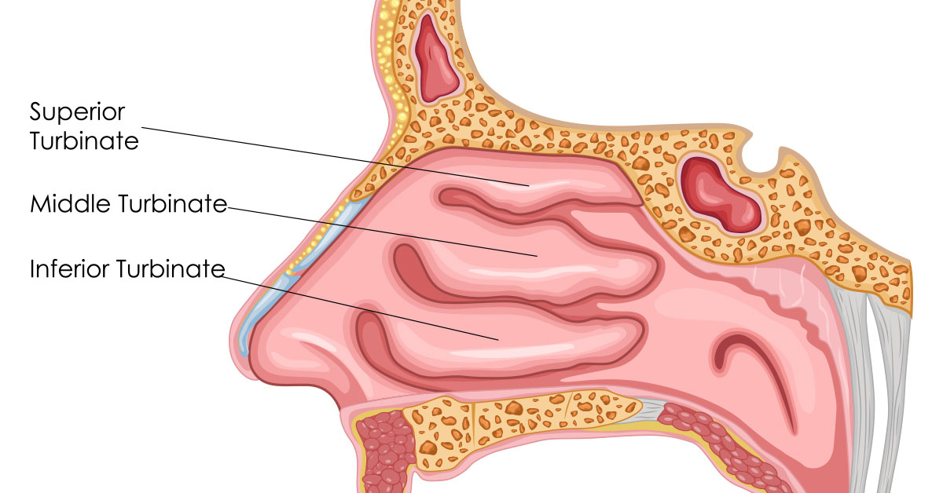
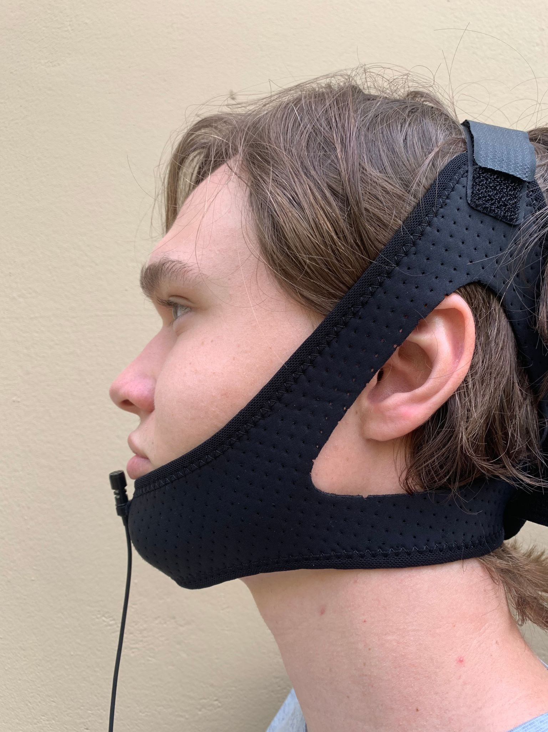
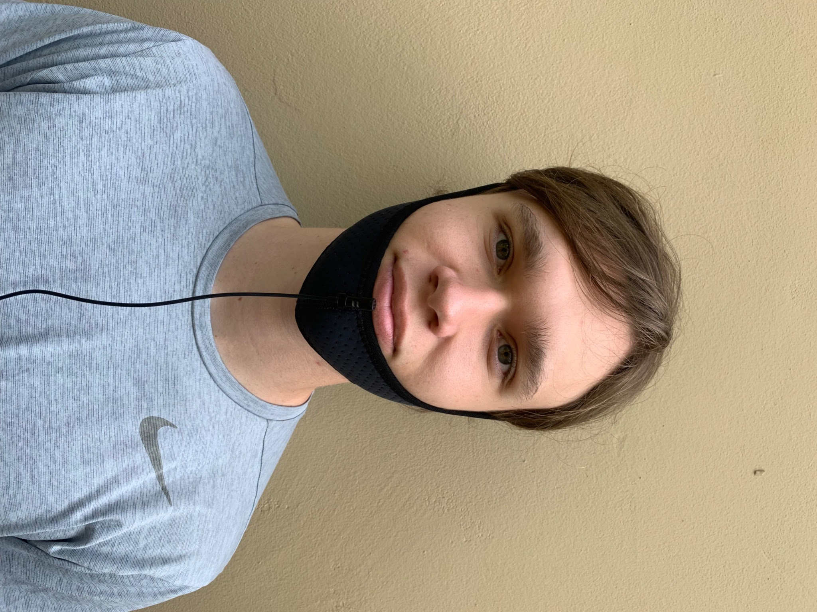
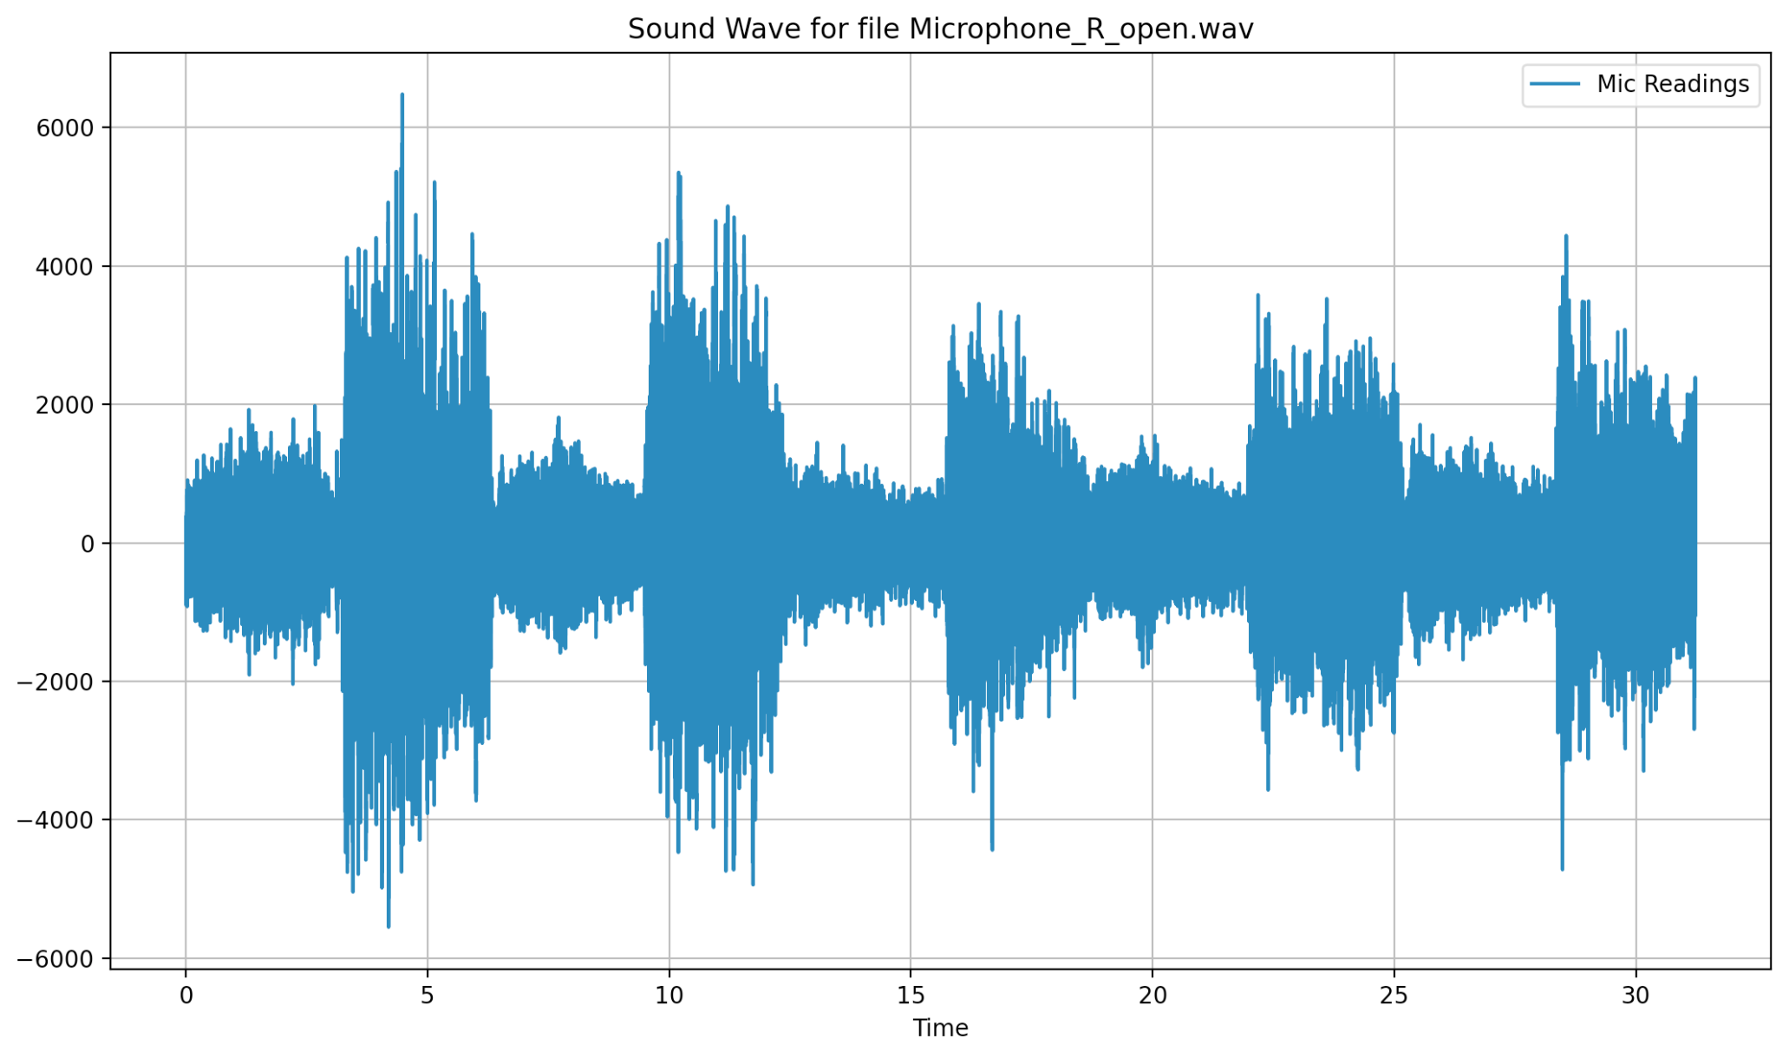
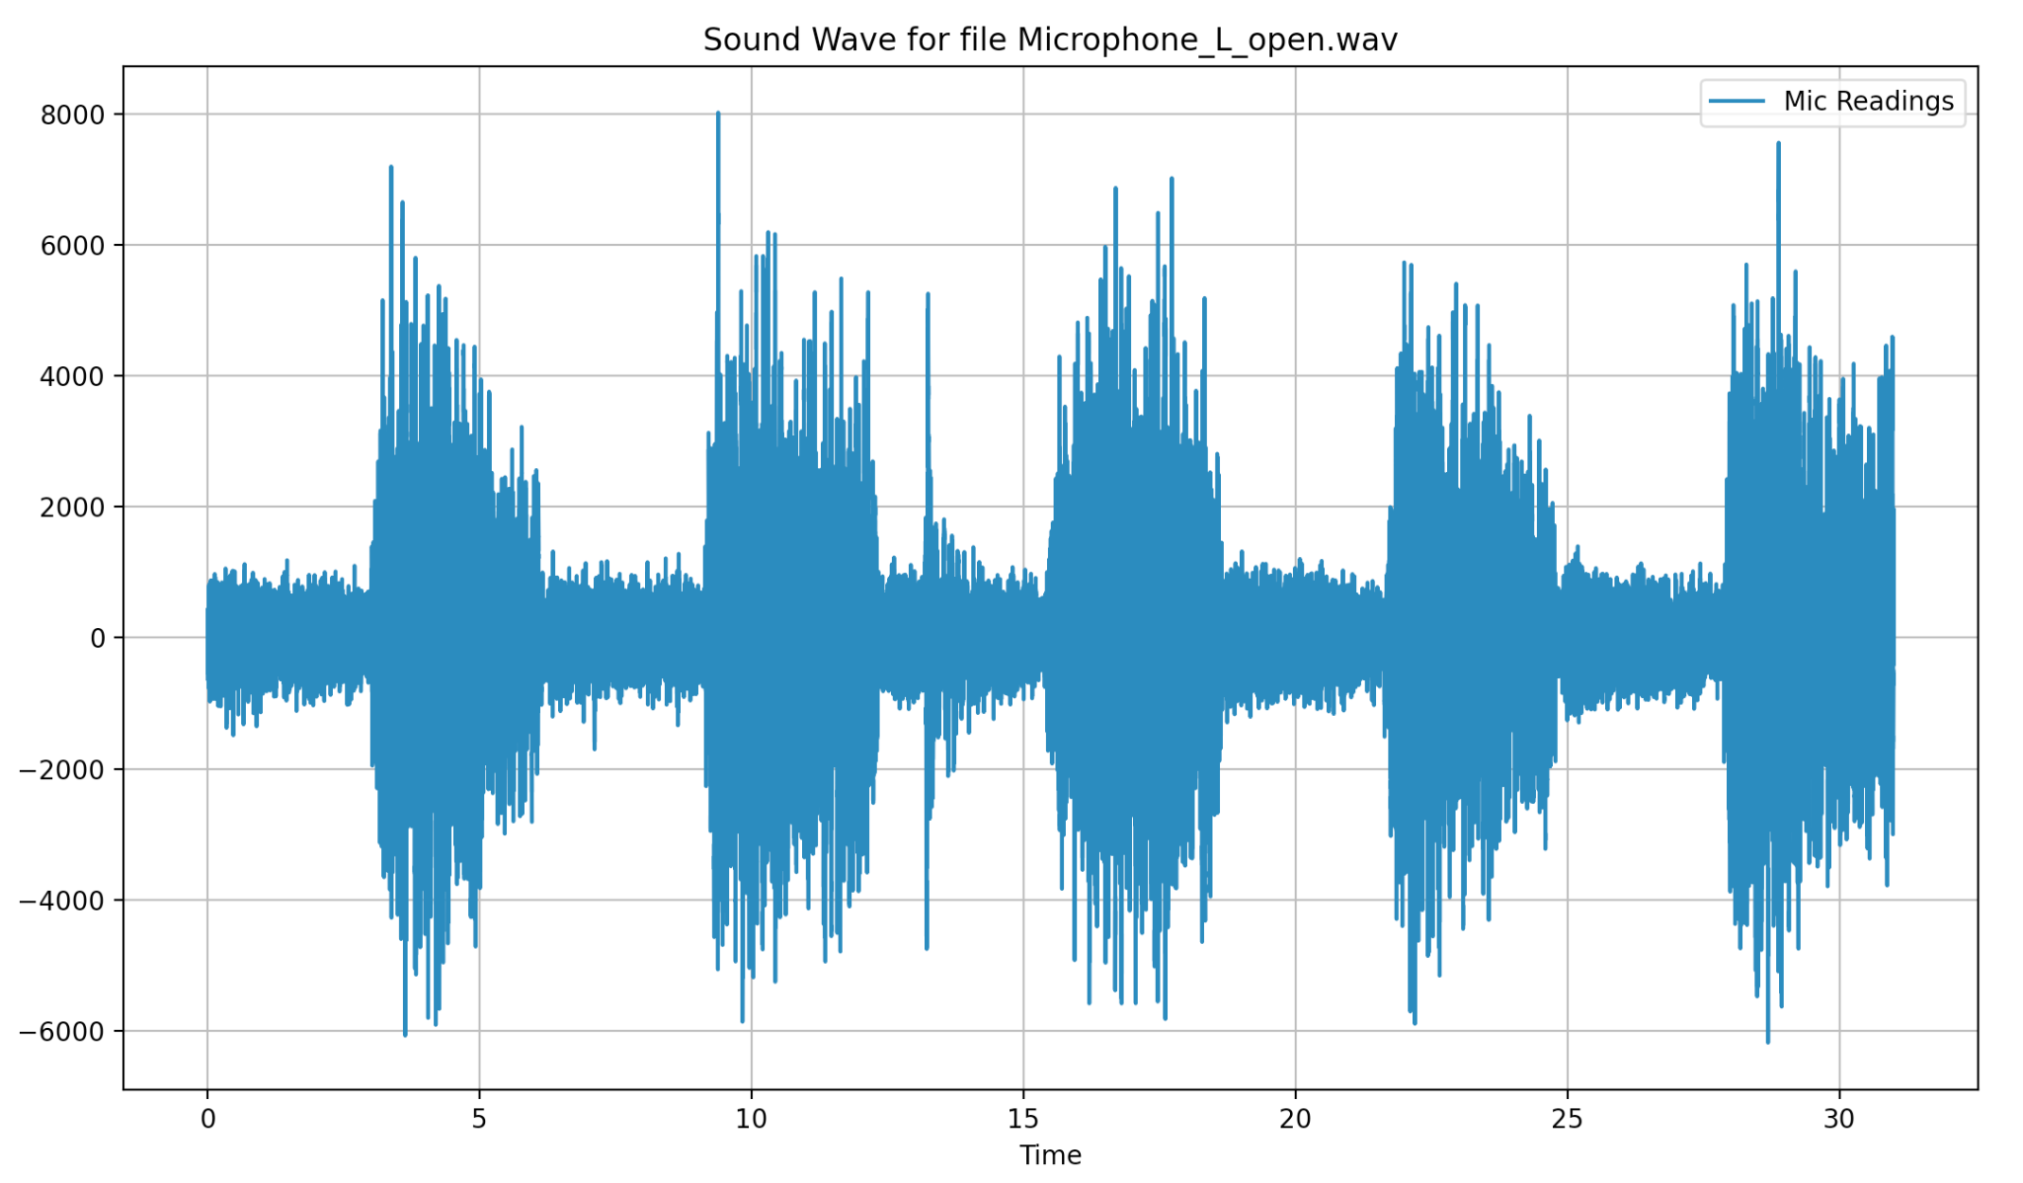
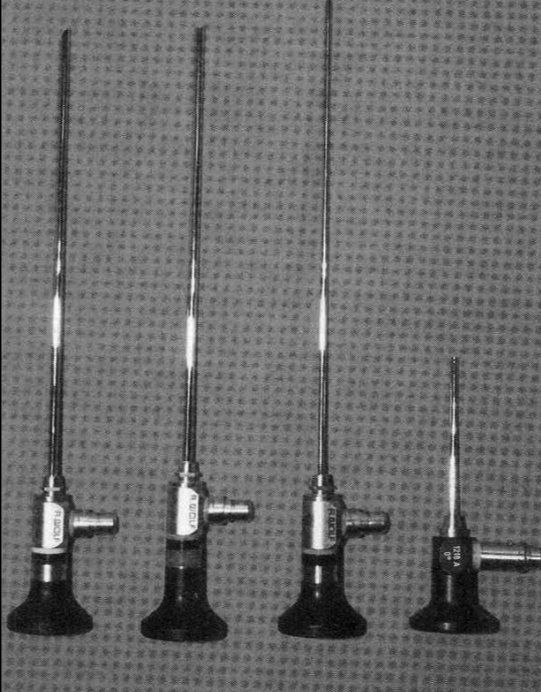
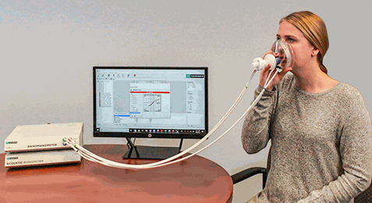
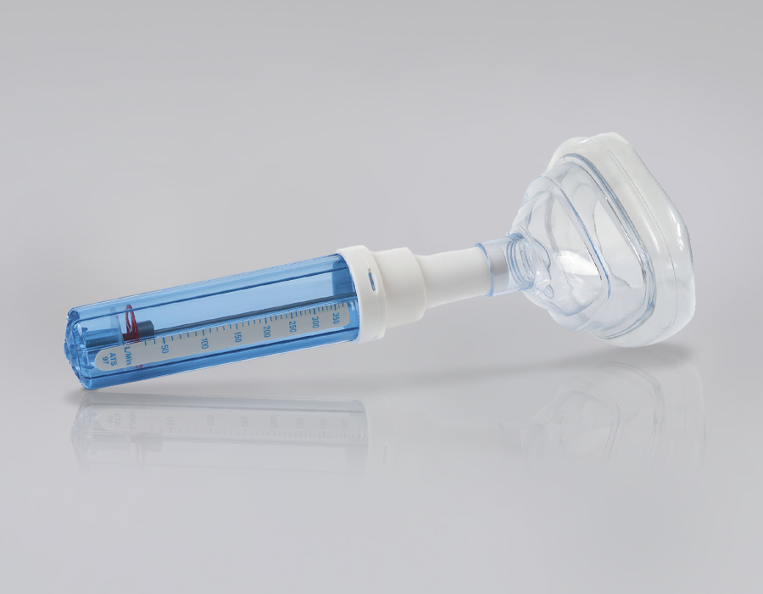
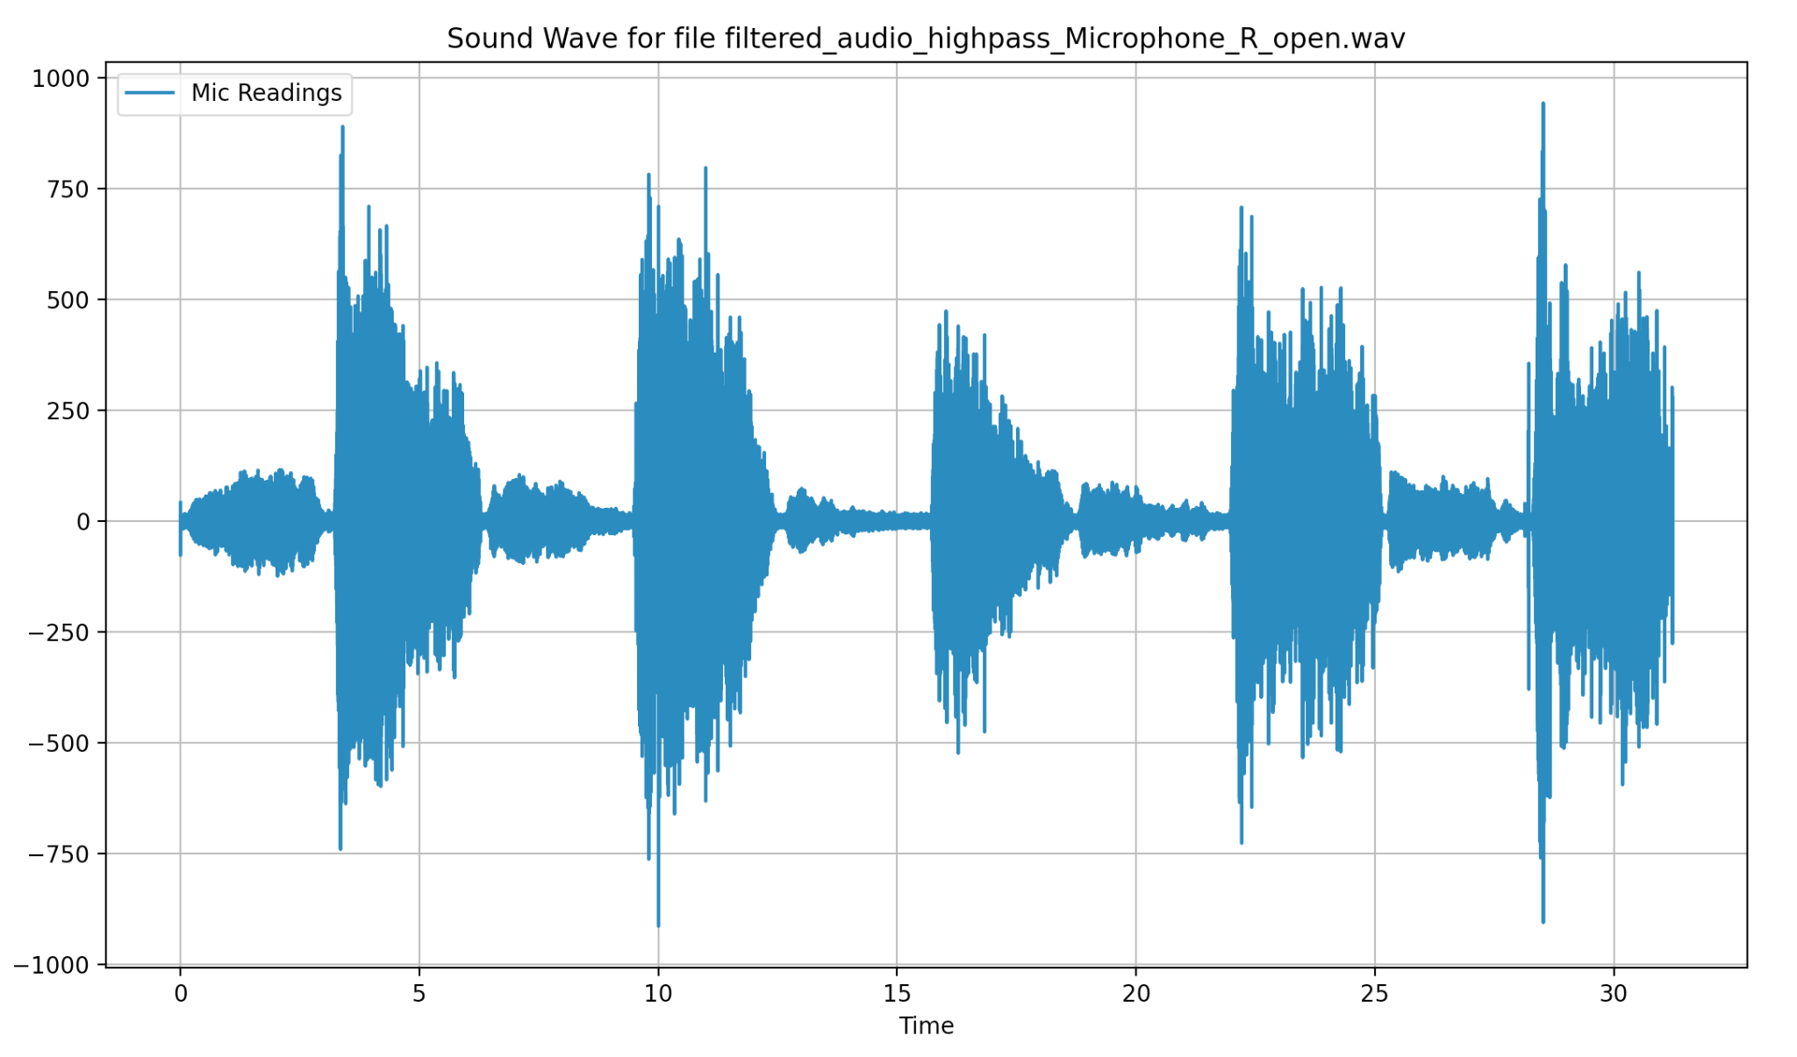
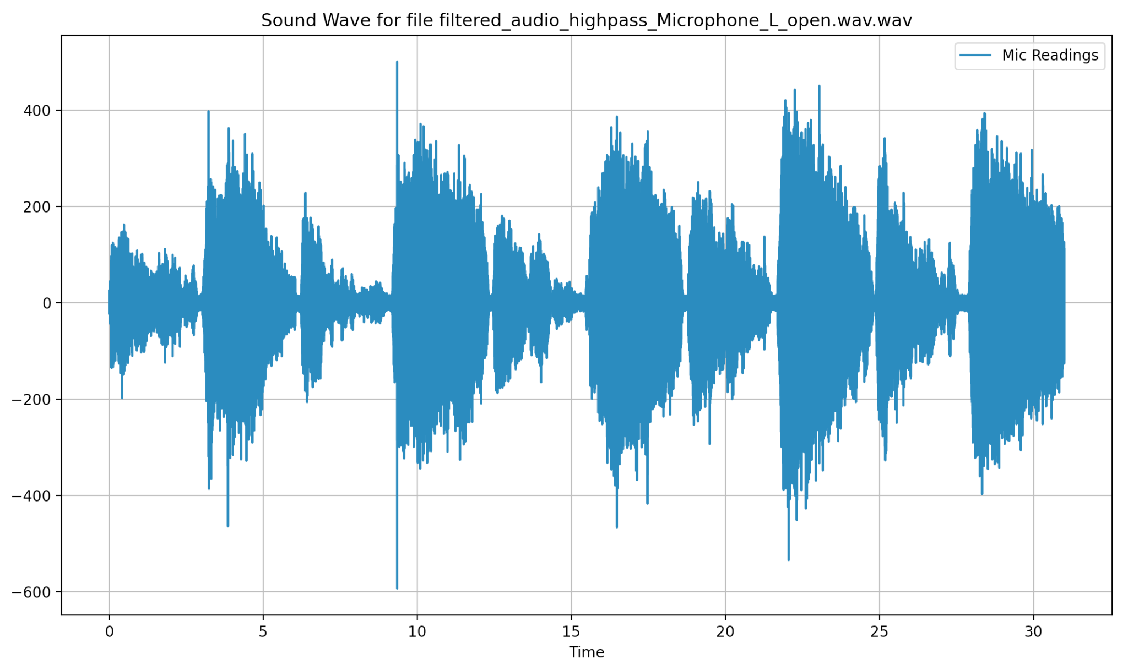
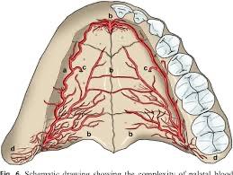
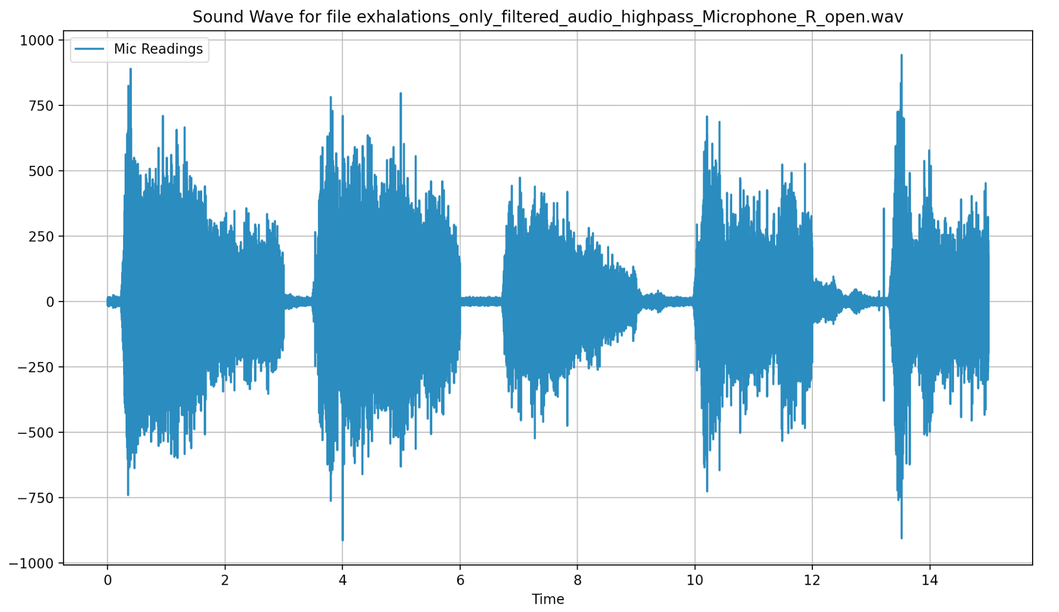
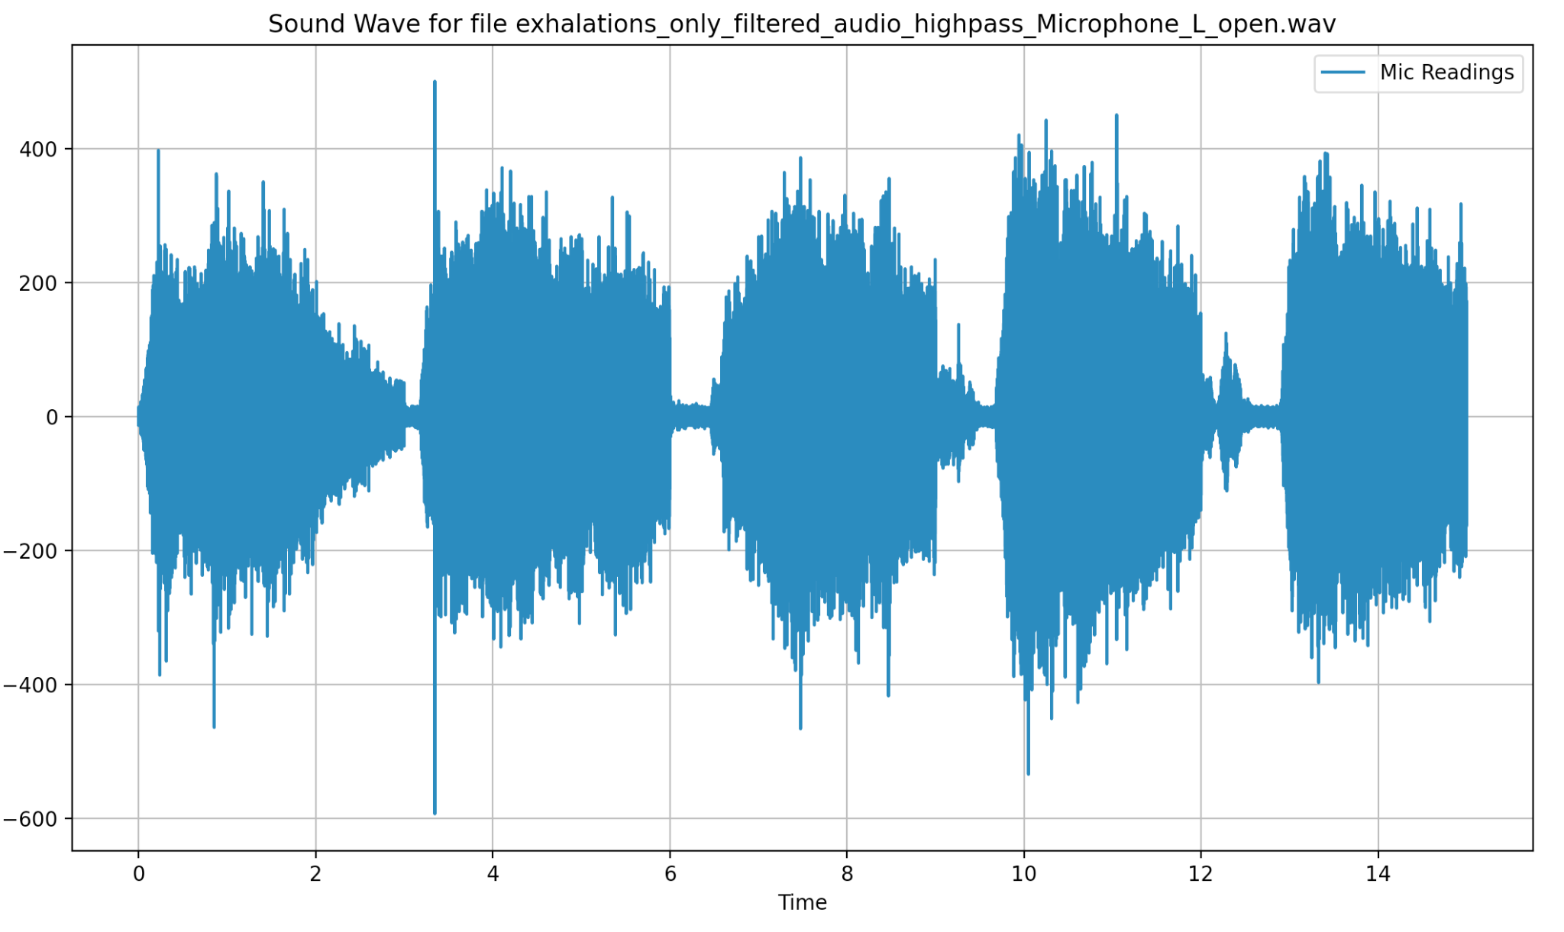
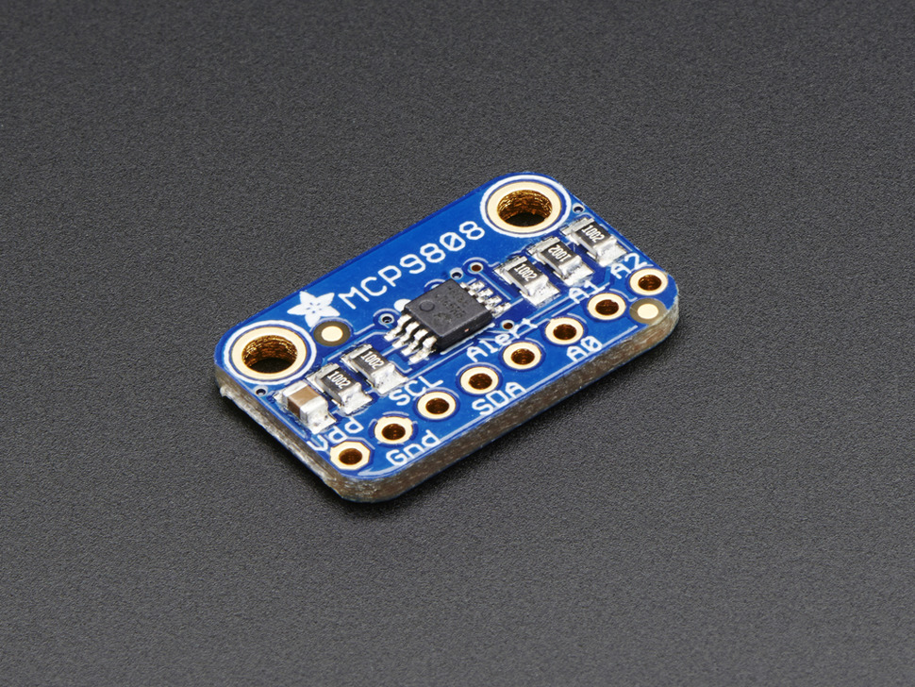
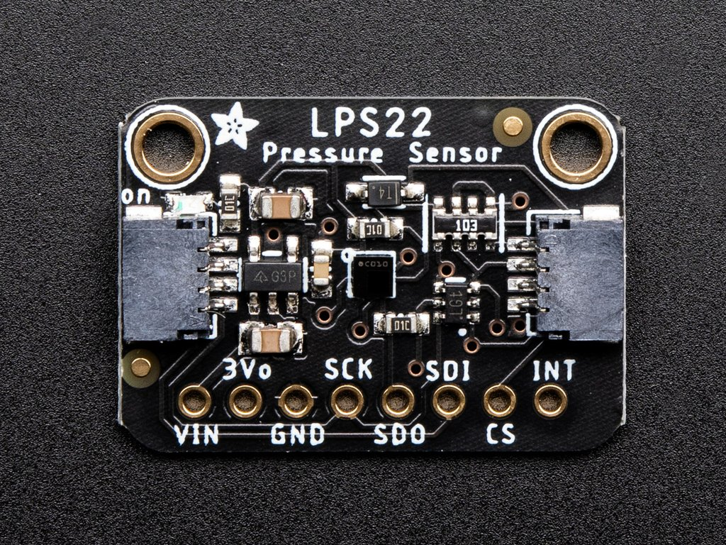
Constructing, Testing, and Evaluating PPG and Microphone Based Methods for Nasal Cycle Detection
Kabir Jolly¹, Cameron Hagey², Dr. Pardis Miri¹
Stanford University¹, Loyola Marymount University²
BACKGROUND
METHODOLOGY AND RESULTS
DISCUSSION
The nasal cycle refers to spontaneous congestion and decongestion of opposite sides of the nose.
Common in mammals, present in ~80% of the human population
Periodic in nature, shifts in the cycle are individual dependent but range from 0.5-2.5 hours on average
Congestion is controlled by tissue-covered flaps in the nose known as turbinates, and turbinate enlargement results in restricted nostril airflow.
Phase I: Turbinate Enlargement Detection with PPG Sensors
We conducted experimentation by blocking a nostril or laying sideways, thus forcing one nostril to dominate breathing over the other. Trials from both PPG-based prototypes were inconclusive.
No replicable or statistically significant relationship between PPG readings and nostril airflow
Laying on one side to force blood flow did not result in a shift between the amplitudes in the readings
Readings were heavily impacted by sensor placement and pressure against the artery
Turbinate enlargement is one of many factors contributing to the nasal cycle, and the greater palatine artery is only connected to one of three nasal turbinates
Preliminary testing and analysis with the microphone readings were more promising.
Testing apparatus resulted in replicable measurements across trials
Placed two PPG sensors on the prototype base
Tested with dental wax and retainer designs
Aligned sensors slightly in front of the first molar on either side
Lateral positioning matched branching of the greater palatine artery
Fastened sensors using waterproof tape for safety purposes
Connected sensors to an Arduino-compatible microcontroller
Wax Prototype
Retainer Prototype
Greater signal amplitude
More blood flow
Classical nasal cycle. Flanagan and Eccles, 1997
Turbinate enlargement
Studies show potential links between the nasal cycle and autonomic nervous system functioning, respiratory infection response, and mental/emotional disorders, motivating further research into nasal cycle detection methods.
Less nostril airflow
There was alignment between computed loudness measurements and peak nasal expiratory flow measurements (our gold standard)
Greater amplitude signal from right (red) sensor
Left nostril dominance?
Greater amplitude signal from left (blue) sensor
Right nostril dominance?
PROPOSED SOLUTION
Phase II: Nostril Dominance Detection with Microphone
AL Nasal & Sinus Center
Current methods are invasive, expensive, or constrained by the necessity to operate in a lab/clinical setting.
Right Nostril Readings
Left Nostril Readings
FUTURE WORK
Nasal Endoscopy
Rhinomanometry and Rhinoflowmetry
Peak Nasal Expiratory Flow
The retainer showed a higher amplitude from the right sensor in every trial. This is due to sensor placement (aligning a flat sensor to the curved palate) or sensor error.
We developed a flexible PPG sensor to place on the retainer and are awaiting its arrival for testing
For the microphone readings, the loudness values are difficult to interpret as a standalone metric, and further measures can be taken to clean the data. We can:
Compare the energy in each audio signal
Utilize a baseline frequency (e.g. a 1 kHz tone) to establish a relative scale such that LUFS and dB values can be more accurately compared
Record ambient noise in the room and filter it out
Further exploration:
Compare results with a rhinomanometer which is the academic convention for nasal cycle detection
Attached an omnidirectional lapel microphone to a sleep apnea chin strap
Maintained a consistent angle towards and distance from each nostril
Covered one nostril using a finger
Performed five inhalation-exhalation sets timed at three seconds each
Recorded audio data with the microphone, processed data, and calculated integrated loudness for each resulting audio file
Original Data
Pownell et al. 1997
GM Instruments
GM Instruments
We aim to create a self-contained retainer that uses photoplethysmography (PPG) sensors to analyze blood flow in the greater palatine arteries, which supply blood to the inferior turbinates.
Furthermore, we want to verify the existence of the nasal cycle with audio-based methods and determine alignment between our two approaches.
High Pass Filtering
Our goals are to create prototypes that are:
Portable/practical for long-term data collection
Cost effective
Comfortable and non-invasive
Audio File
Thresholding
Use a temperature sensor to check cyclic nasal mucous temperature differentials
Use a pressure sensor to check for cyclic air pressure changes
K-Filtering
Summation
Loudness
(LUFS)
Sensor placement on palatine arteries
Inhalation Removal

